Slide 3
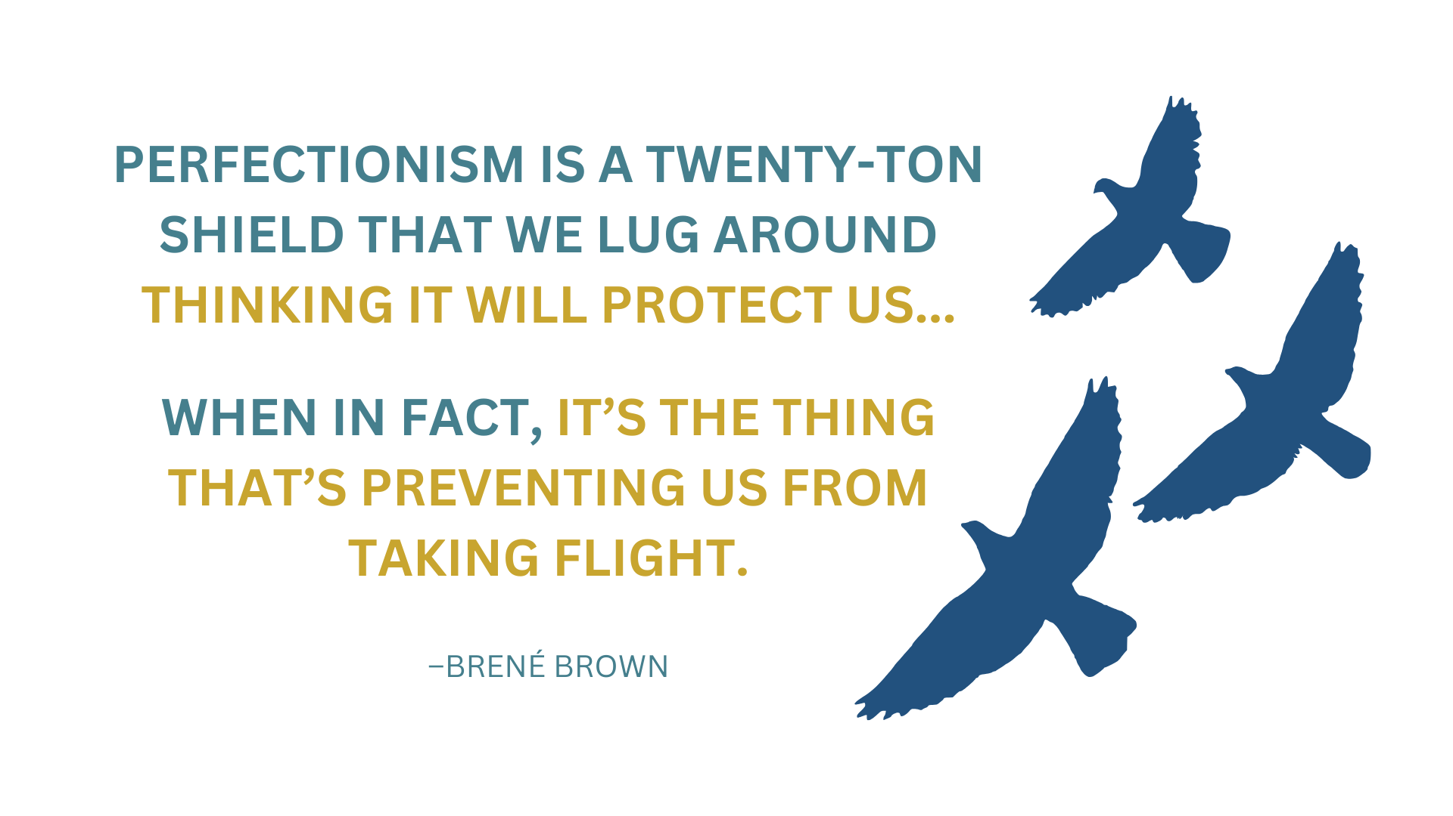

Slide 8
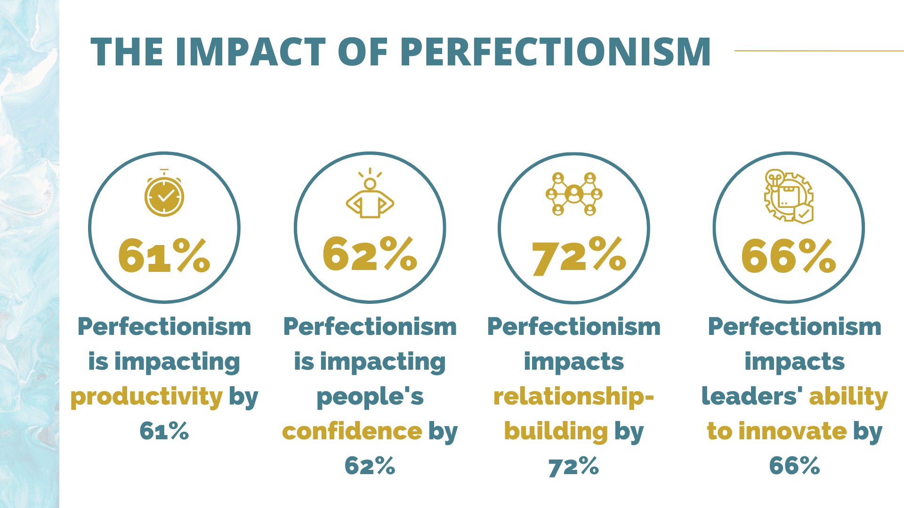

Slide 10
LEADING WITH
IMPERFECTION

Slide 13
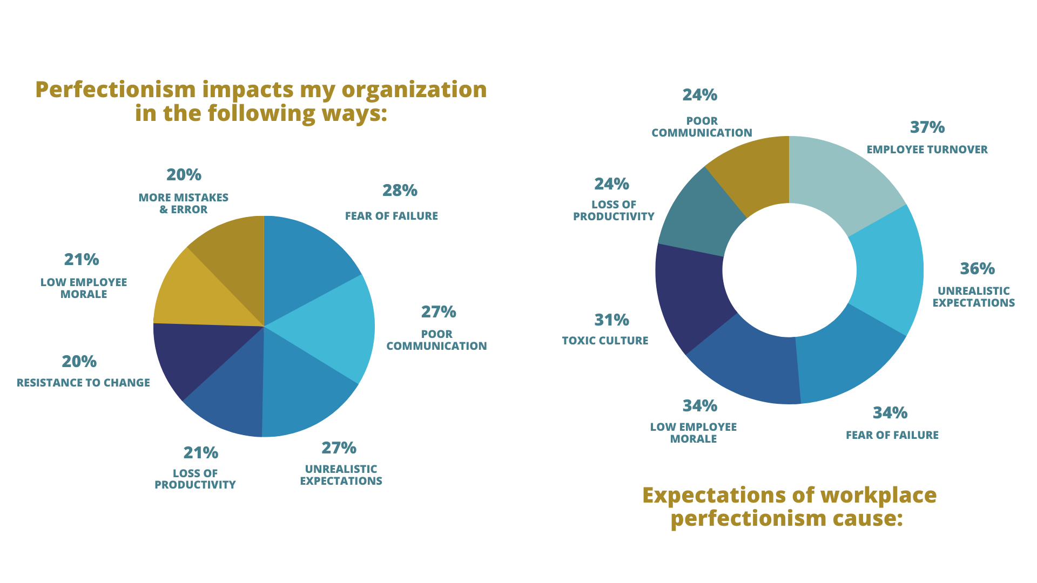

Slide 16
LEADING WITH
IMPERFECTION

Slide 17
LEADING WITH
IMPERFECTION

Slide 18
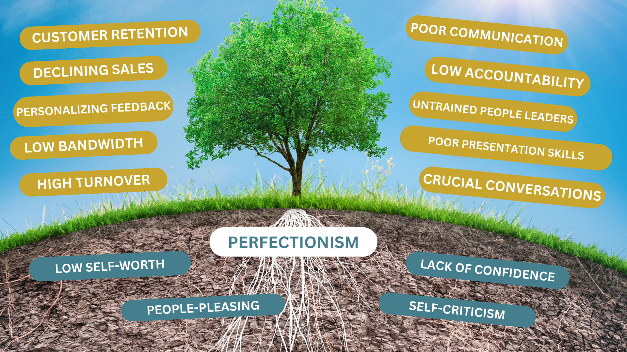
LEADING WITH
IMPERFECTION

Slide 19
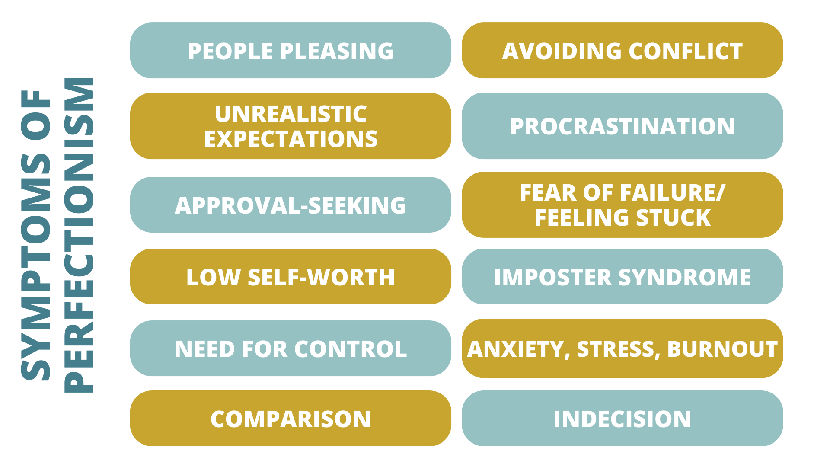
LEADING WITH
IMPERFECTION

Slide 20
LEADING WITH
IMPERFECTION

Slide 21
LEADING WITH
IMPERFECTION

Slide 23
LEADING WITH
IMPERFECTION

Slide 27
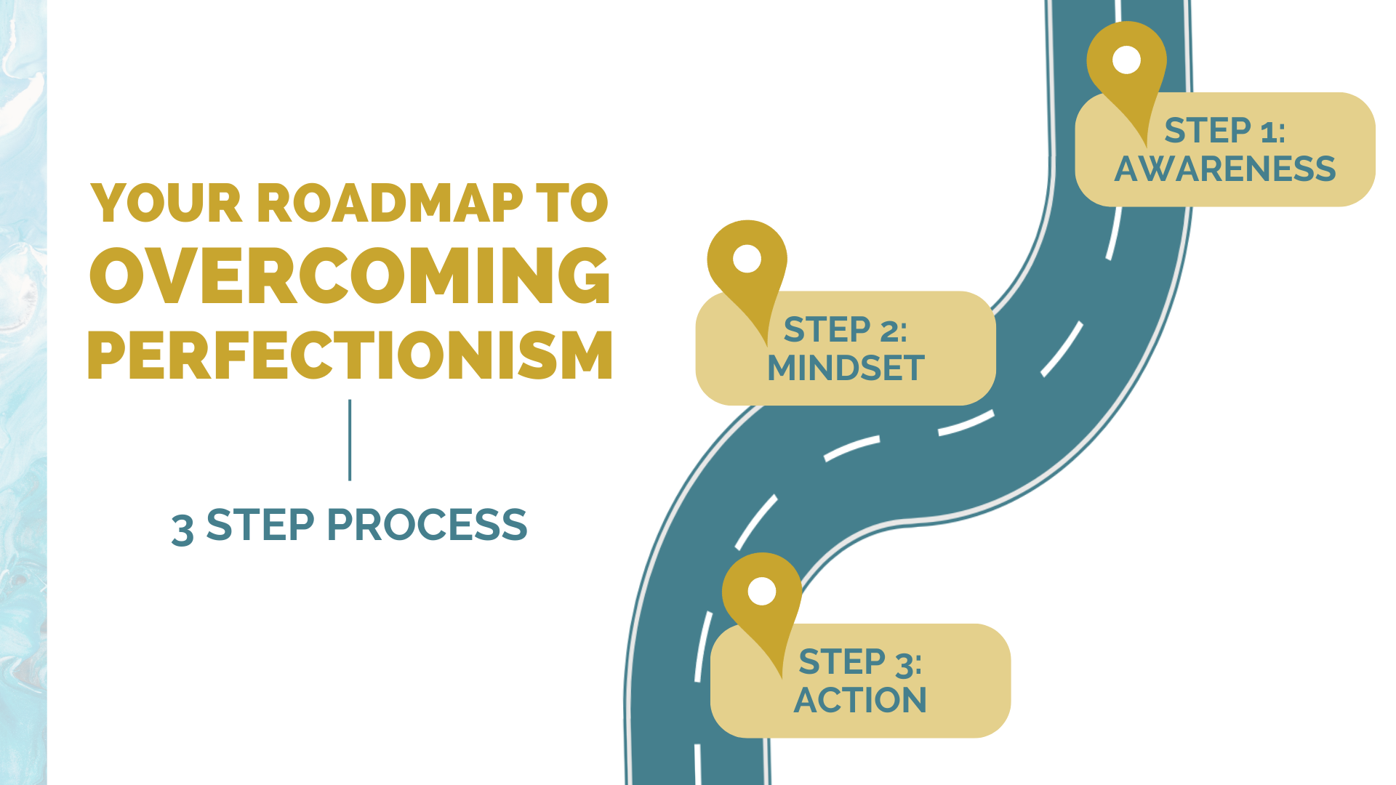

Slide 28
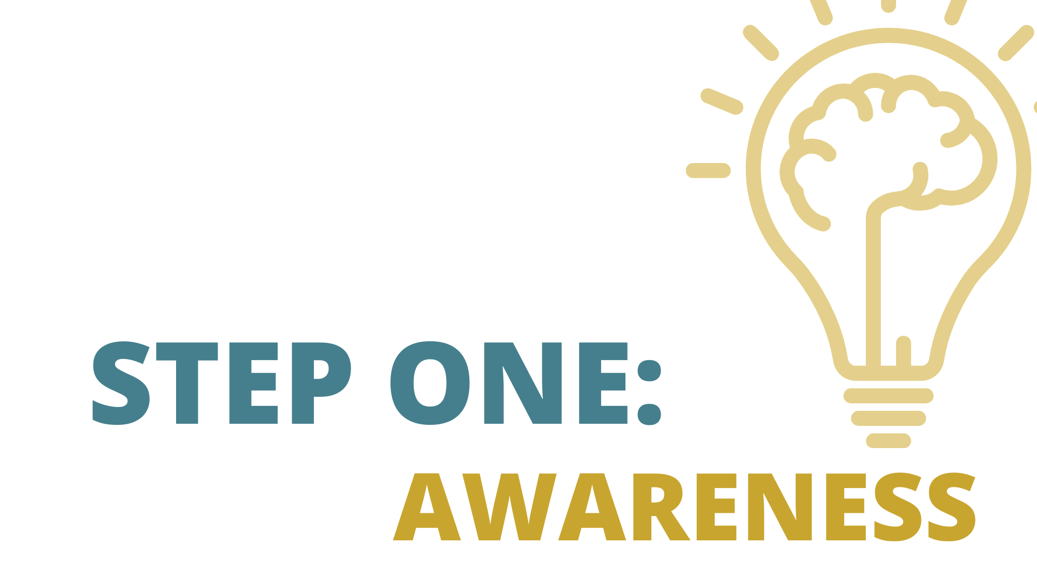

Slide 31
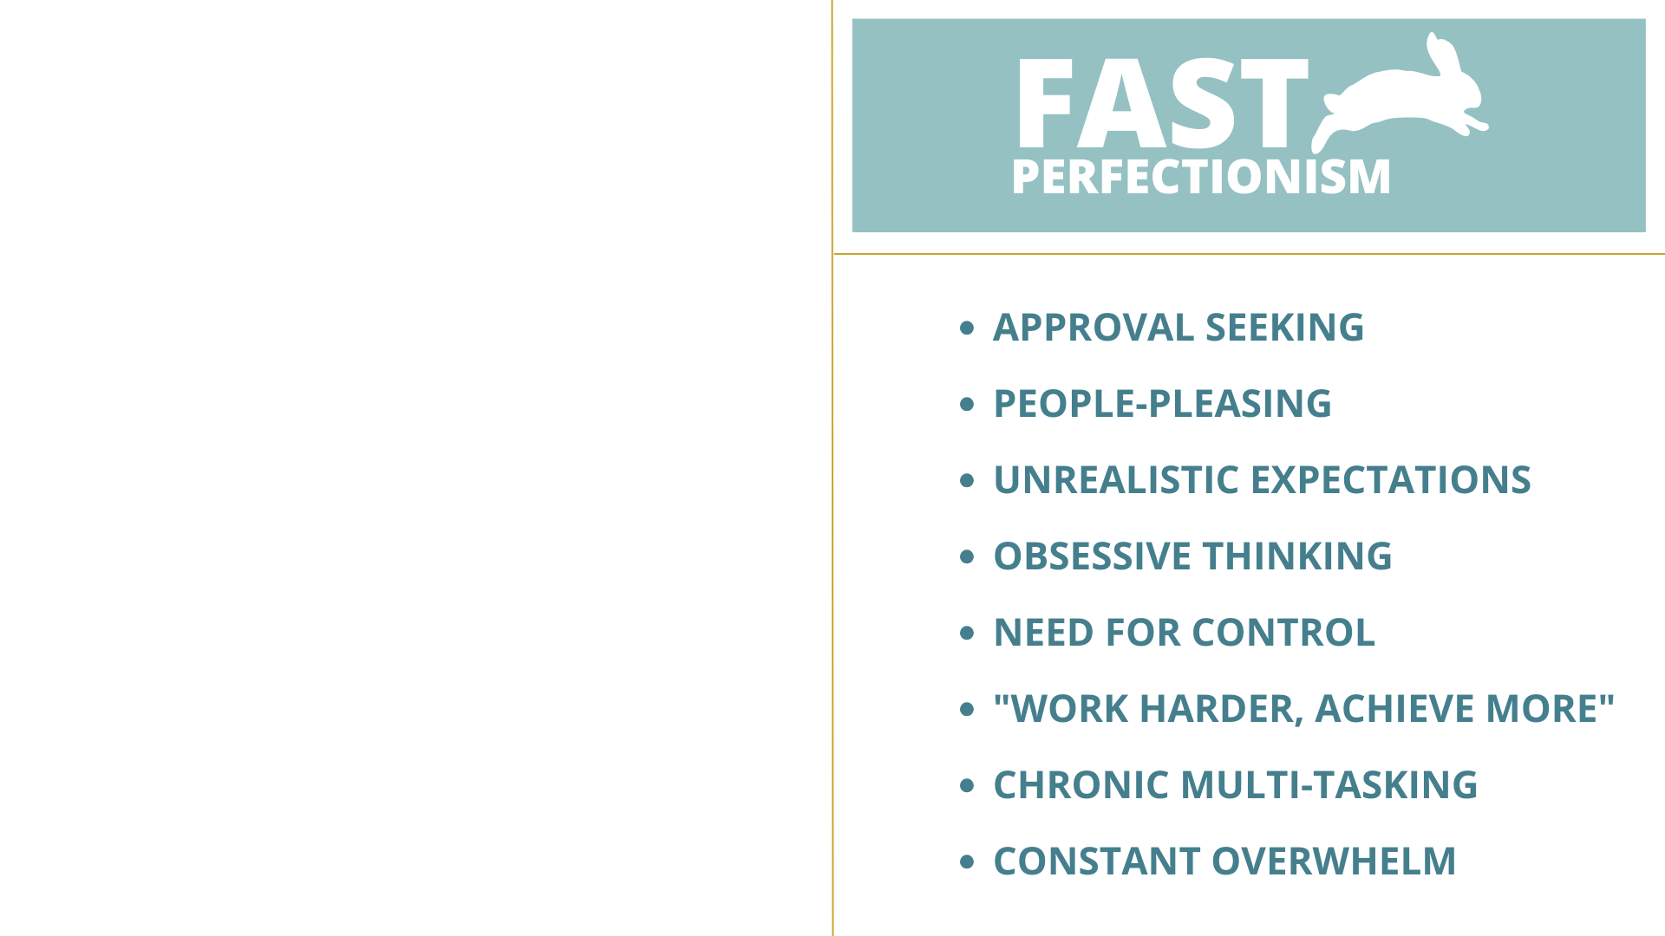

Slide 32
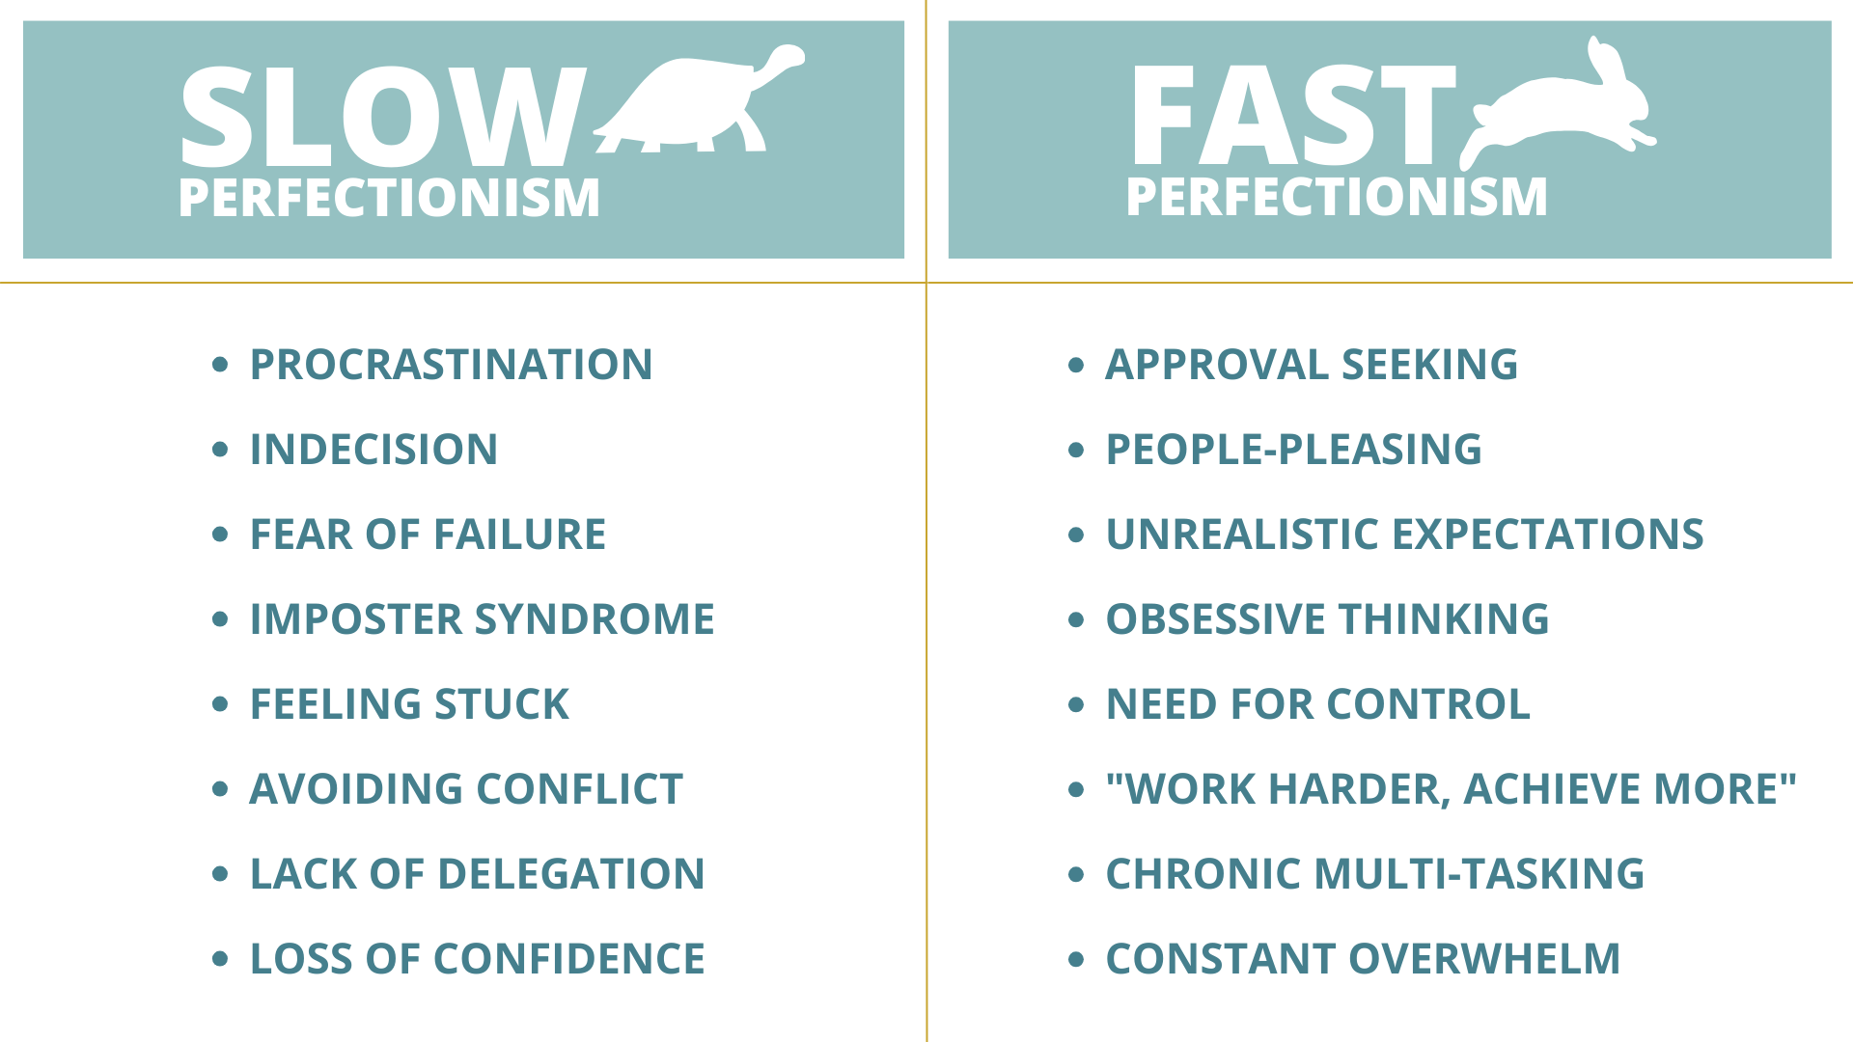

Slide 33
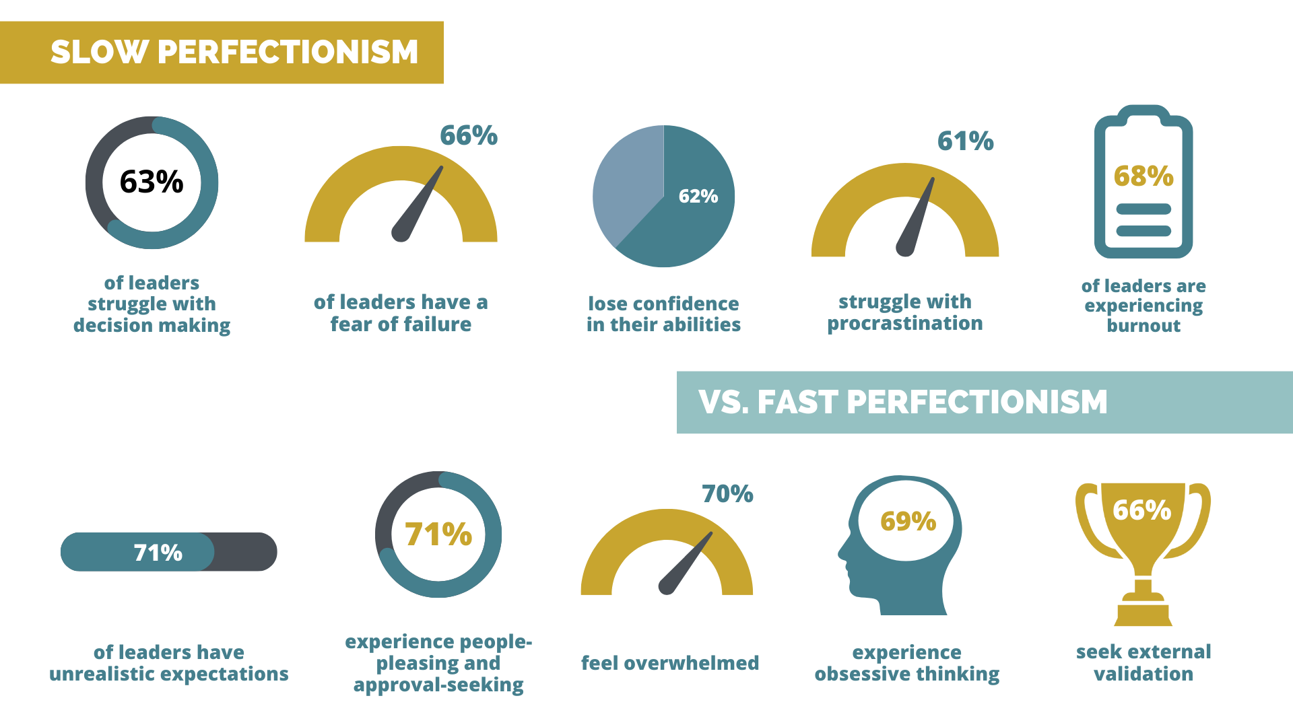

Slide 34
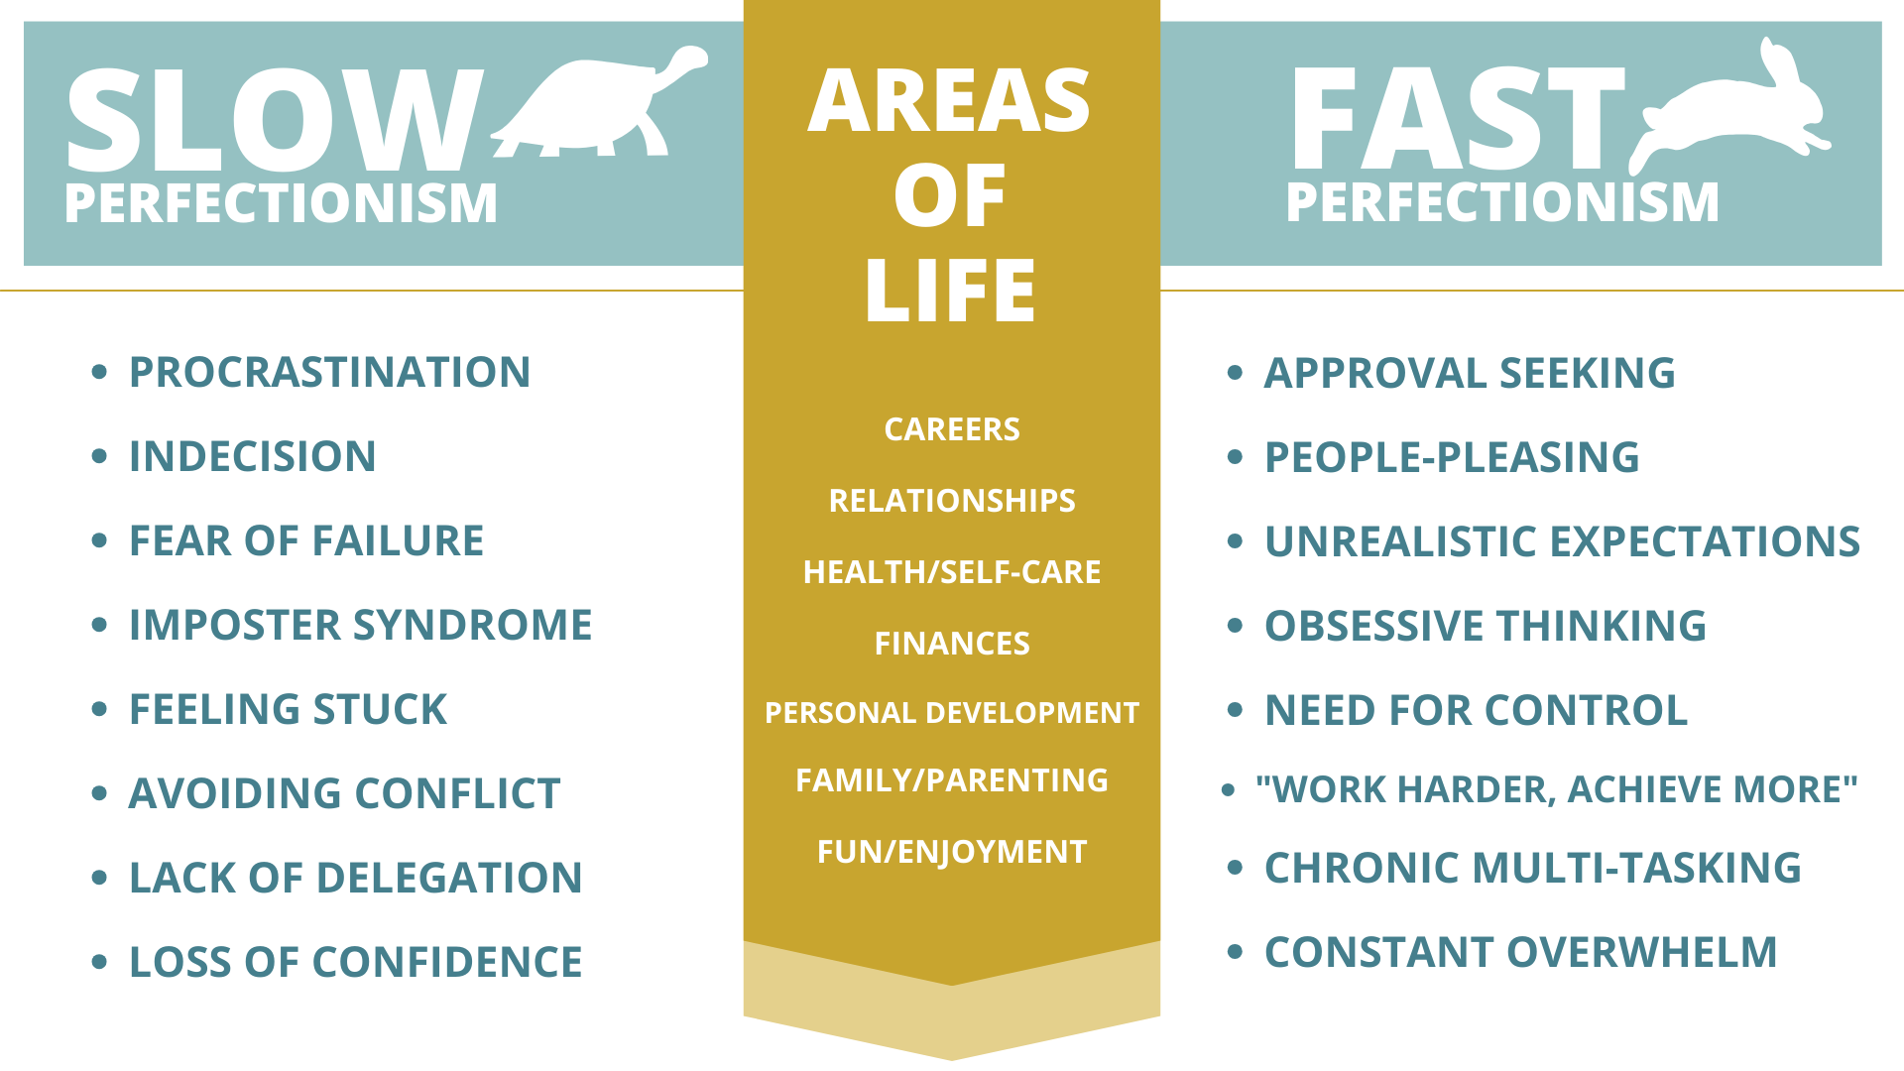

Slide 37
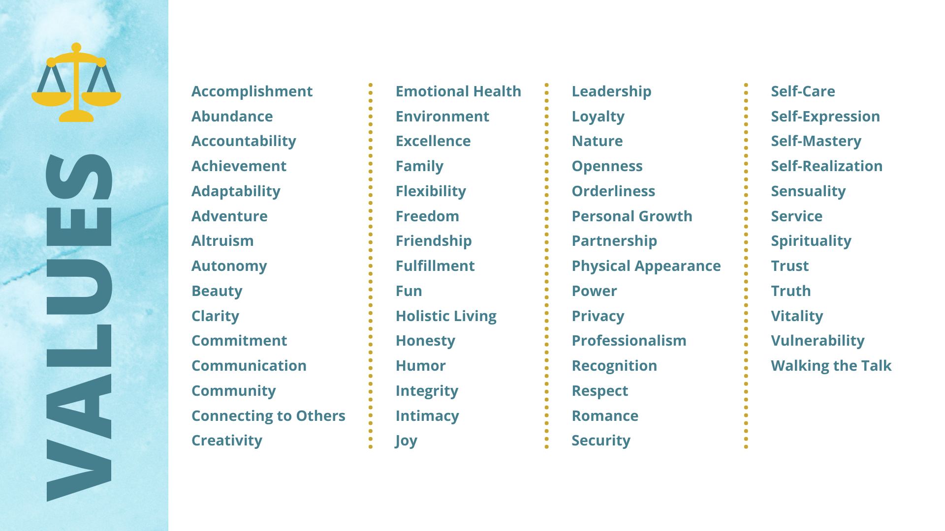

Slide 39
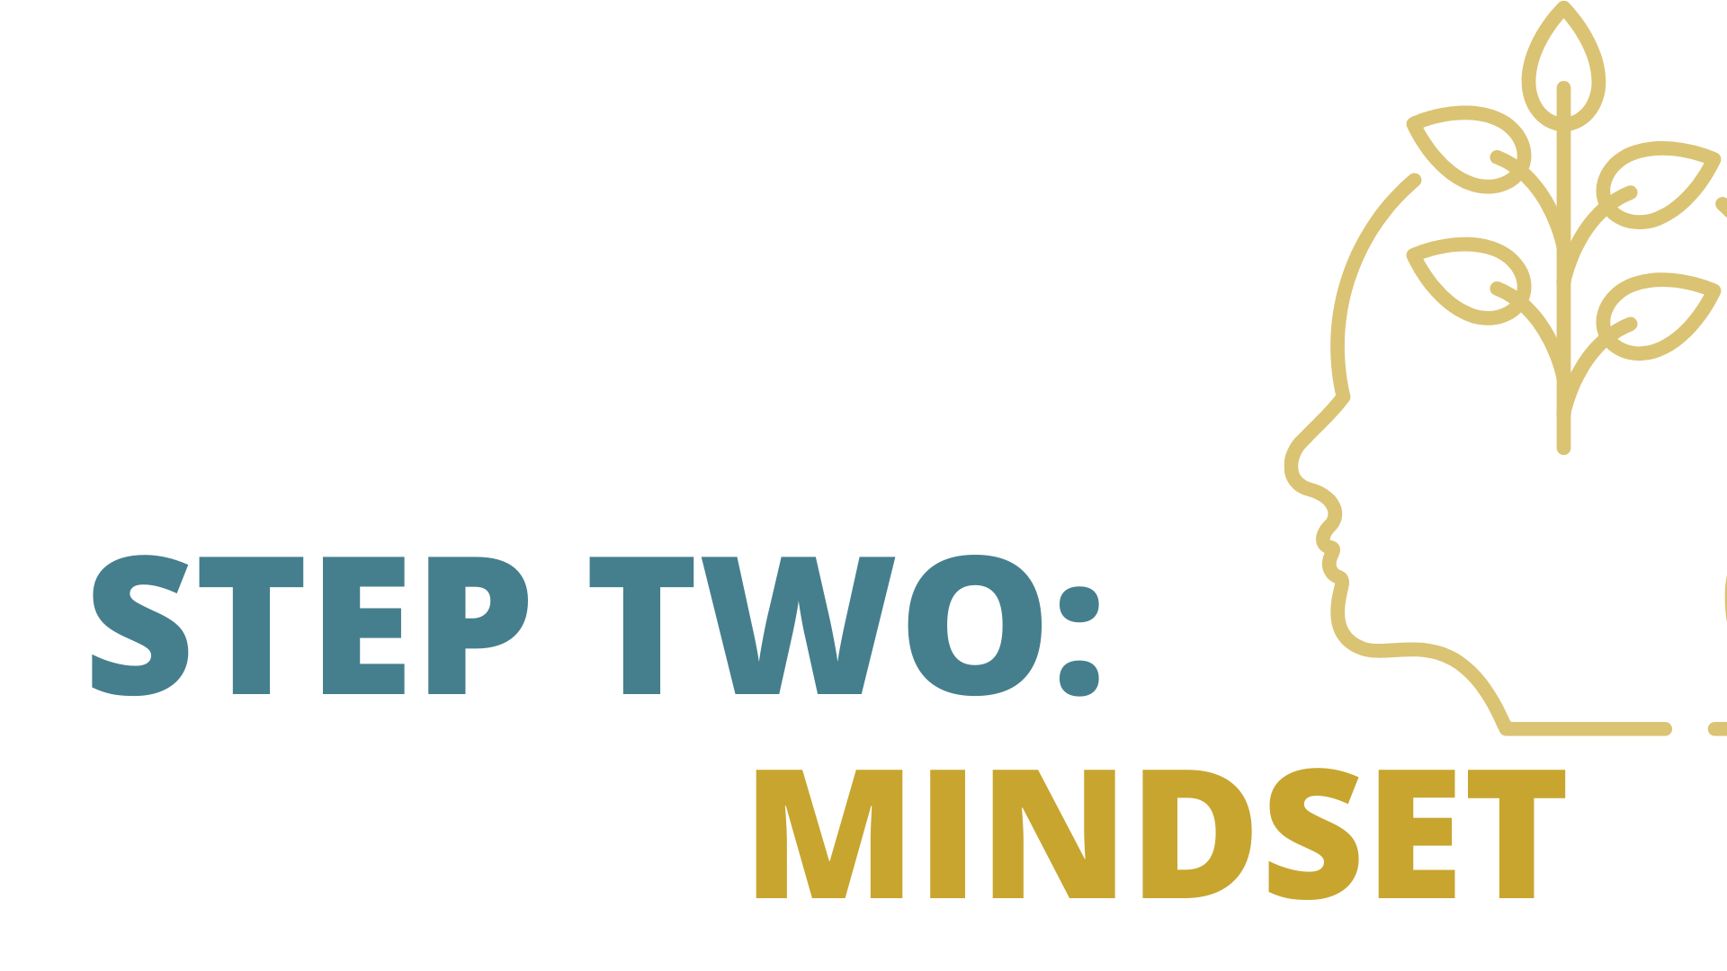

Slide 43
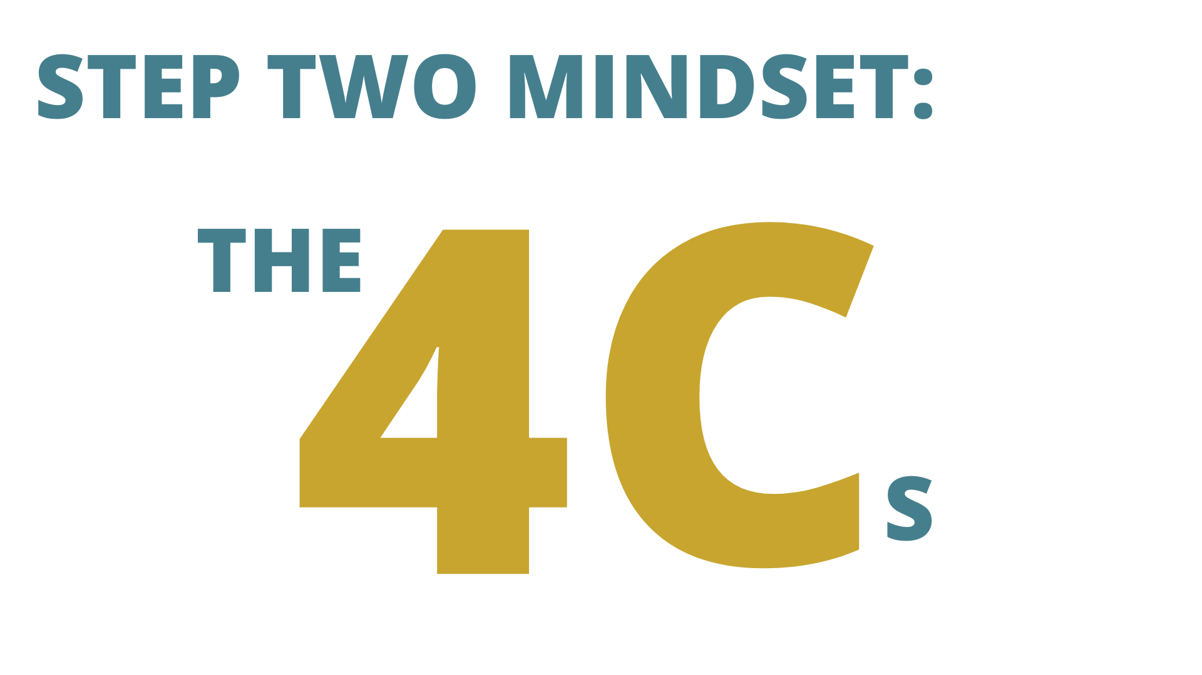

Slide 58
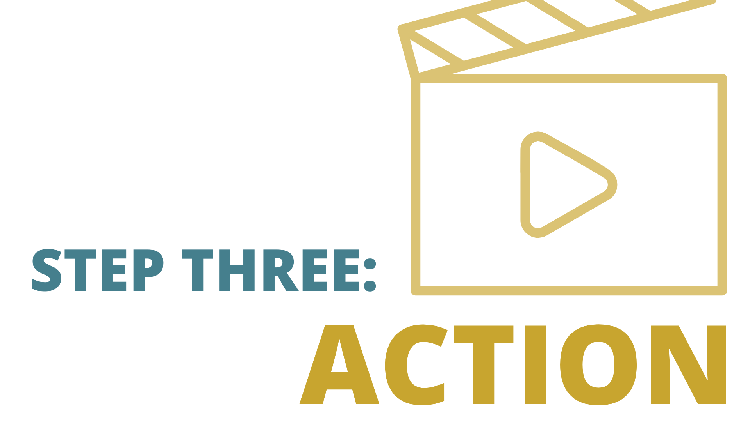

Slide 59
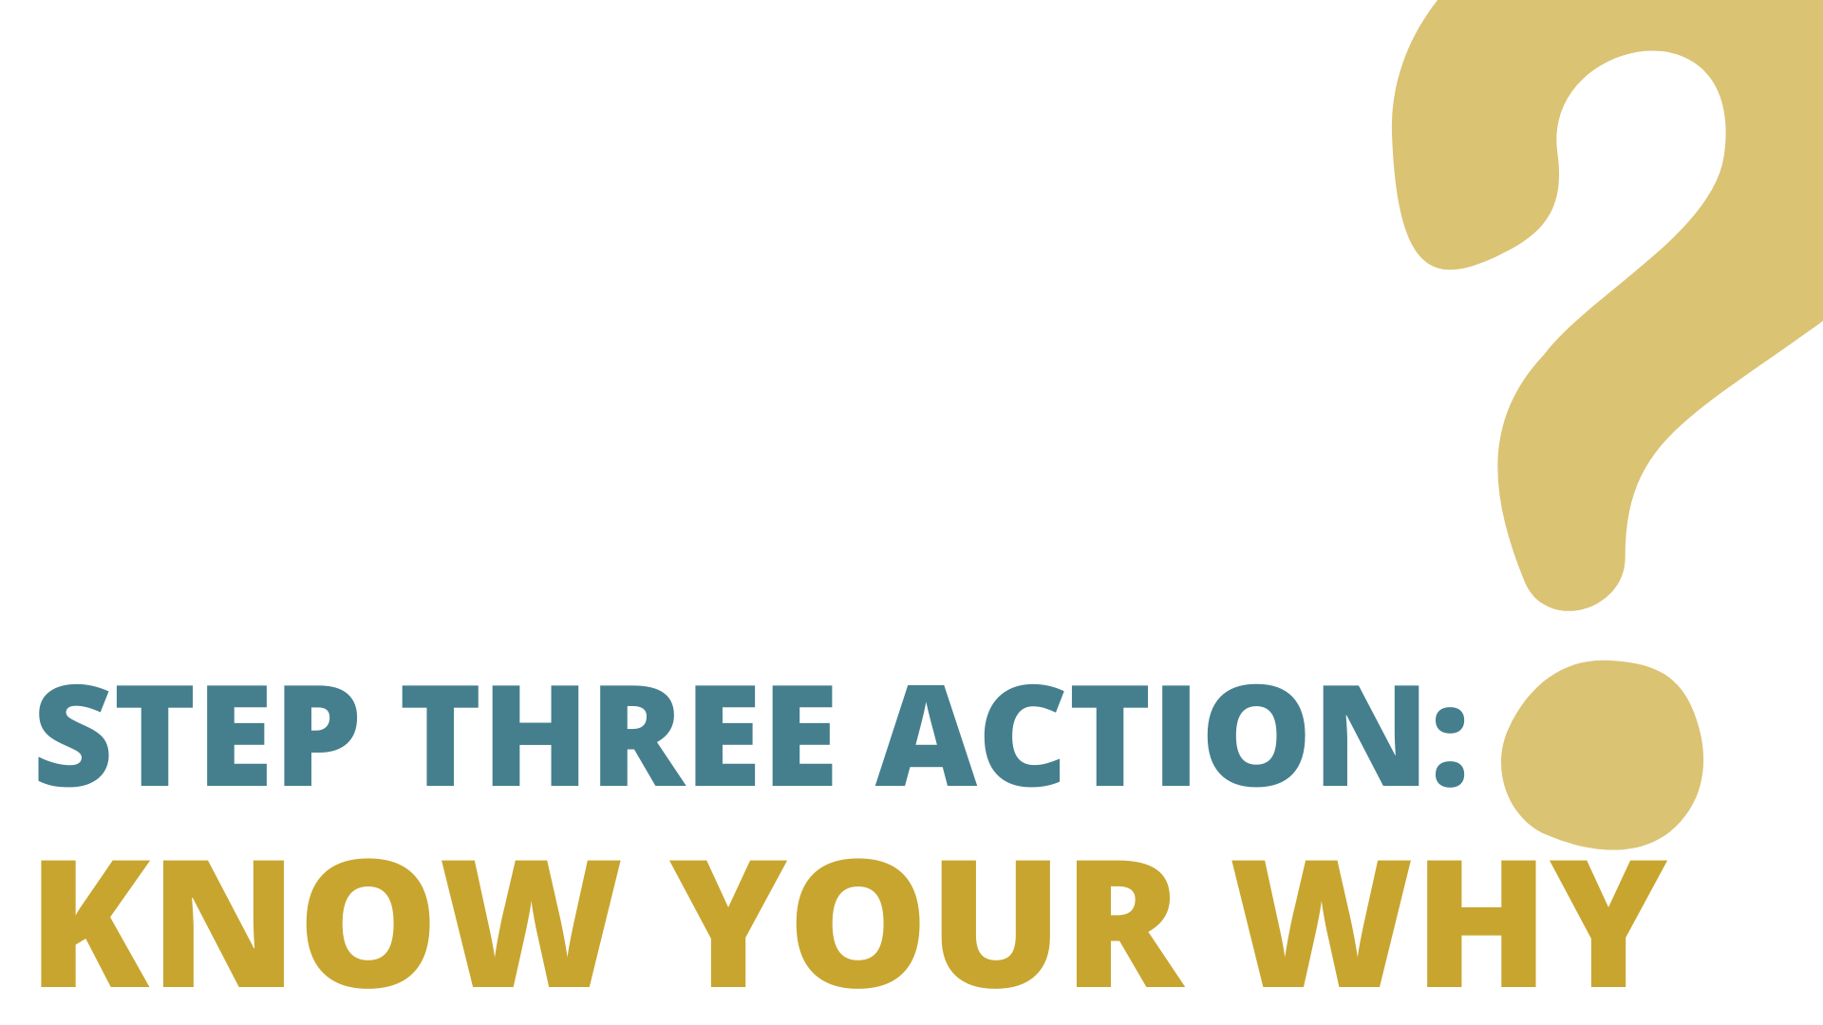

Slide 61
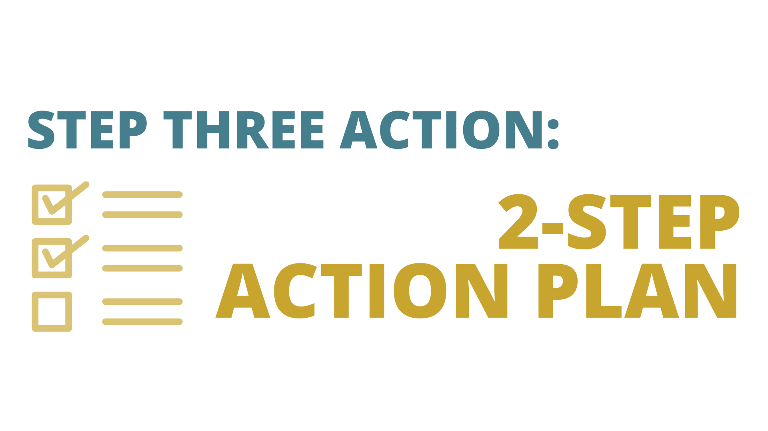

Slide 70
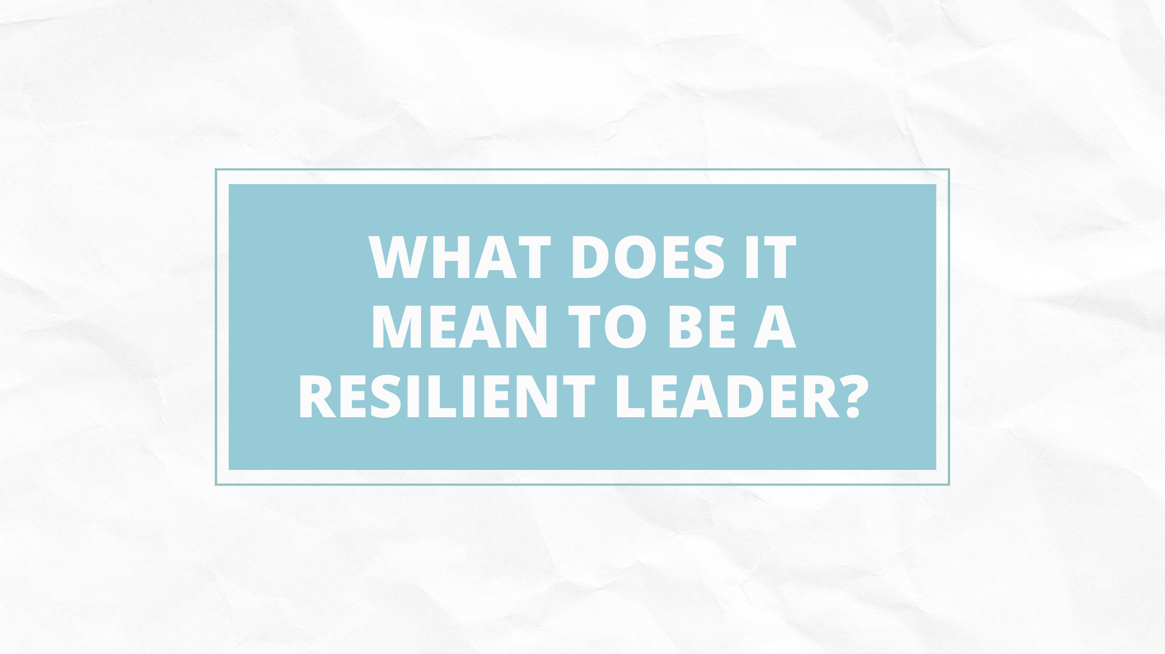

Slide 76
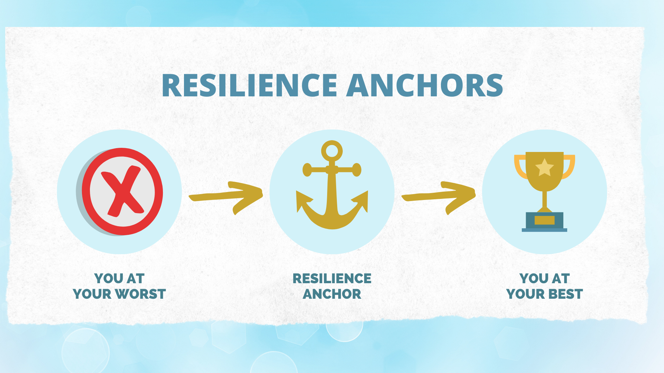

Slide 79
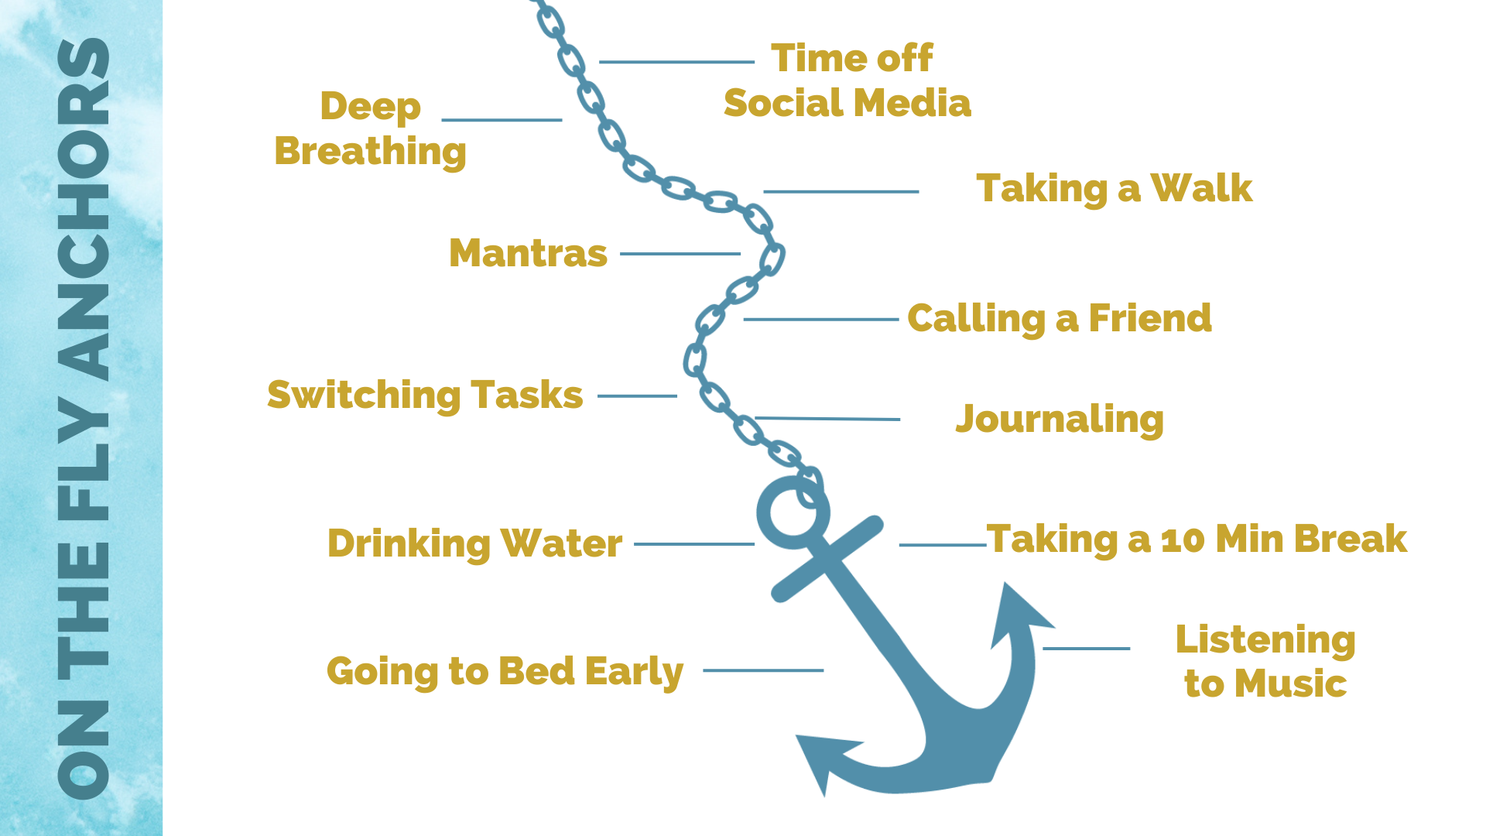

Slide 85
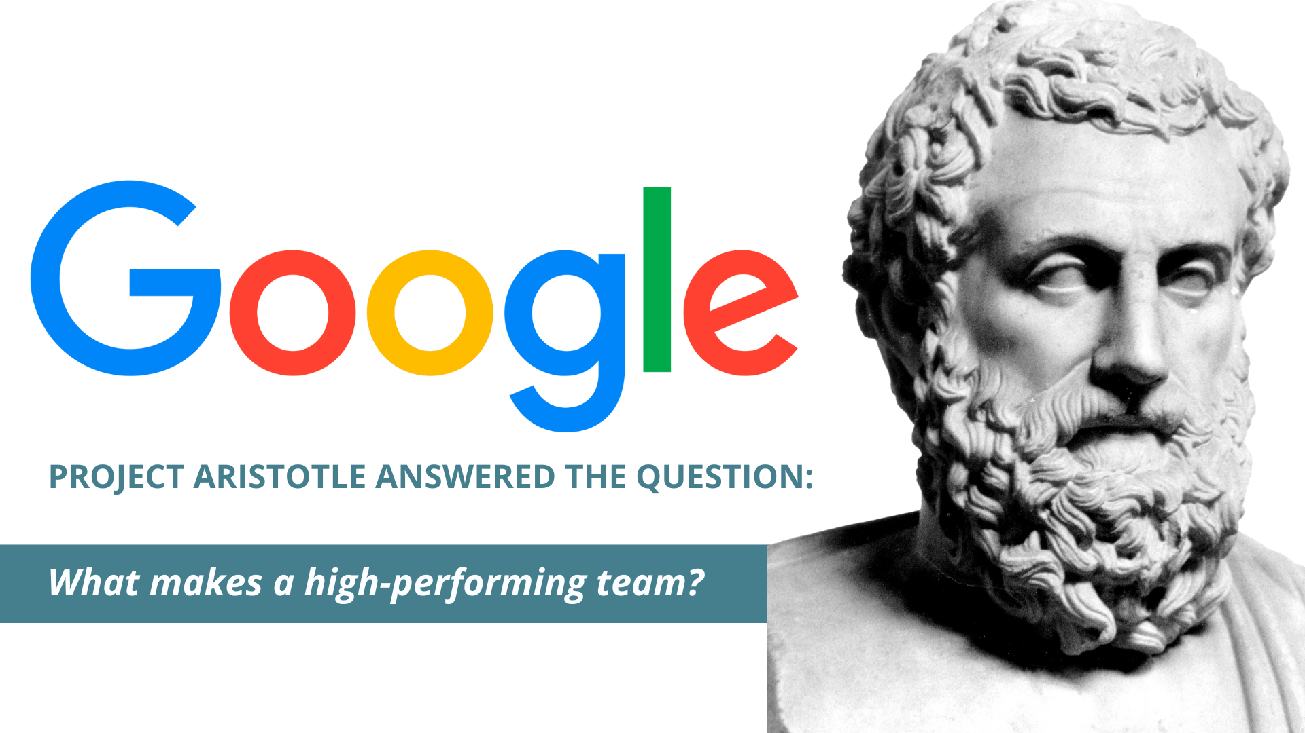

Slide 92
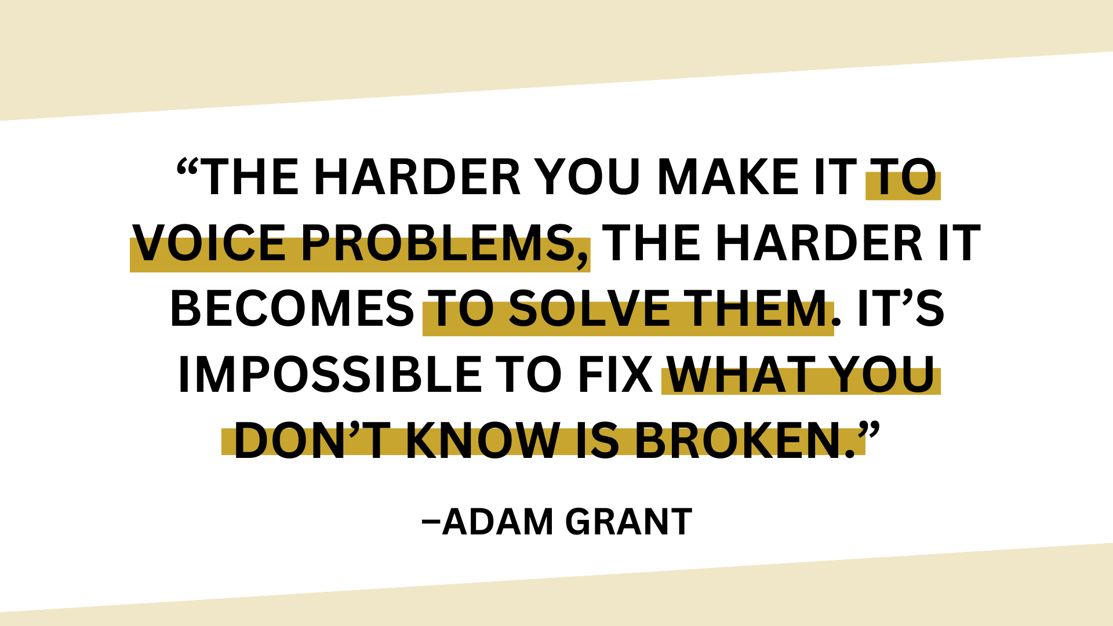

Slide 93
Notes:
Talk about her findings in regard to higher perf hospitals reporting MORE mistakes than lower perf because of pych safety
https://www.aamc.org/news/amy-edmondson-psychological-safety-critically-important-medicine

Slide 95
Psychological Safety
When psychological safety exists, team members feel comfortable being themselves, sharing their thoughts and opinions, and engaging in open and honest communication
They trust that their ideas will be heard and respected, even if they differ from others.
They feel safe taking interpersonal risks, such as speaking up, asking questions, and making mistakes, without the fear of negative consequences or judgment.
Is there a way we can lay this out so it isn’t straight text?

Slide 100
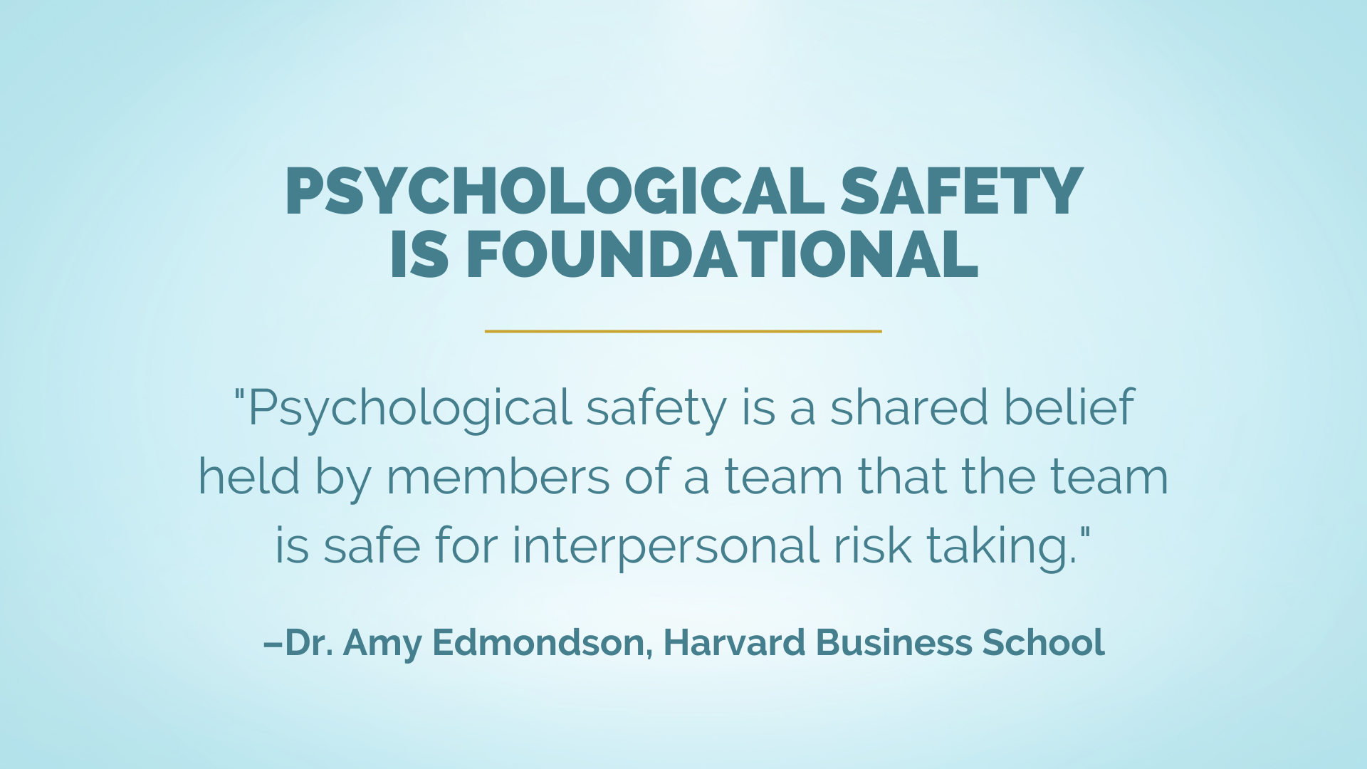

Slide 121
Reflection Activity
What are the ways trust and psychological safety can be created through communication?
What types of communication behaviors and phrases get in the way of trust and psychological safety?

Slide 124
Communication Styles Conflict **Tell Icon
Analytical vs Personal
Intuitive vs Functional

Slide 131
Reflection**Maybe include a “ASK” icon on the slide
Which of the example questions could you start using?
What is something we are working on right now that could be improved by asking the team some good questions?
What types of decisions and/or actions provide the opportunity to engage the team through questioning?
Are there other stakeholders that could benefit from me asking good questions (clients/customers, other department leaders, etc.)?

Slide 132
Reflection**Maybe include a “ASK” icon on the slide
Which of the example questions could you start using?
What is something we are working on right now that could be improved by asking the team some good questions?
What types of decisions and/or actions provide the opportunity to engage the team through questioning?
Are there other stakeholders that could benefit from me asking good questions (clients/customers, other department leaders, etc.)?

Slide 133
The Power of Listening *Include “Listen” Icon
Gather Information
Build Trust
Reduce Conflict
Show Commitment
Strengthen Relationships
Inspire & Motivate
*Make this look vs a list of items on a page

Slide 134
The Power of Listening *Include “Listen” Icon
What makes listening so hard?

Slide 135
The Power of Listening *Include “Listen” Icon
“Most people do not listen with the intent to understand; they listen with the intent to reply.” – Stephen Covey

Slide 136
The Power of Listening *Include “Listen” Icon
3 things good listeners do:
Think before speaking
Listen with respect
Ask, “Is it worth it?”

Slide 143
Reflection
What are your top 3 takeaways?
Based on what you learned today, what are your greatest opportunities for growth as a leader? And what actions can you take?
What steps can you take to build psychological safety and trust on your team?
How will you be more intentional with your relationships by making deposits into their relationship bank accounts?
Where do you need to focus on improving your communication – Tell, Ask, or Listen? What actions can you take?

